Slide 1
Full Stack Application Development
Web Protocols
Communication with Backend
HTTP Polling
Akshaya Ganesan

Slide 2
HTTP Polling

Slide 3
Long running Transactions
API that performs tasks that could run longer than the request timeout limit.
The server typically replies with a 202 Accepted Response indicating that the request is accepted and is in progress.
HTTP is a unidirectional protocol, which means the client always initiates the communication.
So client has to periodically check the server , if the work has been completd.

Slide 4
HTTP Polling
HTTP Polling is a mechanism where the client requests the resource regularly at intervals.
If the resource is available, the server sends the resource as part of the response.
If the resource is not available, the server returns an empty response to the client.

Slide 5
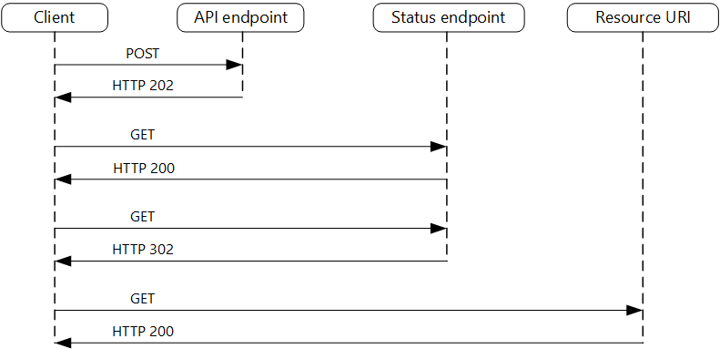
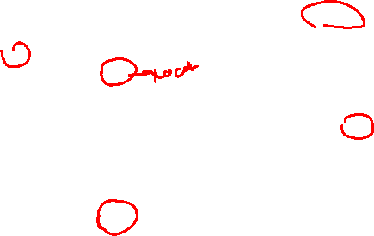
HTTP Polling

Slide 6
HTTP Polling
An HTTP 202 response should indicate the location and frequency that the client should poll for the response.
It should have the following additional headers:
Location
A URL the client should poll for a response status.
Retry-After
This header is designed to prevent polling clients from overwhelming the back-end with retries.

Slide 7
HTTP Polling

Slide 8
Thank You!

